Slide 1
Problem-solving
Solving problems by searching
Informed Search and Exploration
Constraint Satisfaction Problems
Adversarial Search

Slide 2
A simple problem solving agent formulates a goal and a problem, searches for a sequence of actions that would solve the problem, and then executes the actions one at a time. When this is complete, it formulates another goal and starts over. Note that when it is executing the sequence it ignores its percepts : it assumes that the solution it has found will always work.

Slide 3
WELL DEFINED PROBLEMS AND SOLUTIONS
A problem can be defined formally by four components
The initial State that the agent starts in.
A description of possible actions available to the agents
A Goal test, which determines whether a given state is a goal state.
A path cost function that assigns numeric cost to each path.

Slide 4
EXAMPLE PROBLEMS
Toy Problems
Vacuum world Problem.
States : The agent is in one of two locations,
each of which might or might not
contain dirt. Thus there are 2 x 2² = 8
possible world states.
Initial State : Any state can be designated as the initial state
Successor function : This generates the legal states that result from trying the three actions (left,right,suck)
Goal test : This checks whether all the squares are clean.
Path Cost : Each step costs 1, so the path cost is the number of steps in the path.

Slide 5
Other Toy problems
8-Puzzle Problem
8-Queens Problem
Real-world Problems
Route-finding problem
Knapsack Problem

Slide 6
SEARCHING FOR SOLUTIONS
Search Tree
Generate & Test
Measuring problem-solving performance
Completeness
Optimality
Time Complexity
Space Complexity

Slide 7
Uninformed Search Strategies
Breadth-first Search
Optimal when all step costs are equal,because it always expands the shallowest unexpanded node.
Uniform Cost Search
It expands the node n with the lowest path cost. It doesn’t care about the number of steps a path has, but only about their total cost.
Depth First Search
Depth-Limited Search
DLS means DFS with a predetermined depth limit l

Slide 8
Depth-first Search
Search Strategy Properties
Criteria
  Completeness: if there is a solution will the algorithm find it?
  Time complexity: how much time does the algorithm take to arrive at a solution, if one exists?
  Space complexity: how much space does the algorithm require?
  Optimality: is the solution optimal?

Slide 9
In-Completeness of DFS
DFS is not complete
  fails in infinite-depth spaces, spaces with loops
Variants
  limit depth of search
  avoid re-visiting nodes.
  avoid repeated states along path
    => complete in finite spaces

Slide 10
DFS with depth limit Performance
Properties
  Complete: No
    Guaranteed to stop
    Complete only if exists solution at level l<d (where d is the maximum depth)
  Time complexity: O(b^d)
    Best case l
    Worst case (b^(d+1)-1)/(b-1)
      Where b is the branching factor
    improved performance when there are many solutions
  Space complexity: O(bd)
    i.e., linear space
  Optimal: No

Slide 11
DFS Summary
Advantages
  Low space complexity
  Good chance of success when there are many solutions.
  Complete if there is a solution shorter than the depth limit.
Disadvantages
  Without the depth limit search may continue down an infinite branch.
  Solutions longer than the depth limit will not be found.
  The solution found may not be the shortest solution.

Slide 12
Breadth-first Search
Expand node with minimal depth.
avoid revisiting nodes. Since every node is in memory, the additional cost is negligible.

Slide 13
BFS Performance
Properties
  Complete: Yes (if b is finite)
  Time complexity: 1+b+b^2+…+b^l = O(b^l)
  Space complexity: O(b^l) (keeps every node in memory)
  Optimal: Yes (if cost=1 per step); not optimal in general
    where b is branching factor and
    l is the depth of the shortest solution

Slide 14
Uniform cost Search
Expand least-cost unexpanded node
  the breadth-first search is just uniform cost search with f(n)=DEPTH(n)
  Node discovery
  Stop at first expanded goal node
A
1
10
5
B
5
S
G
15
5
C

Slide 15
Uniform cost Search
Properties of Uniform-Cost Search
  Complete: Yes, if step cost >= e (epsilon)
  Time complexity: # of nodes with f <= C*
    C* = cost of optimal solution
    Worst case O(b^(C*/e))
    O(b^l) if step costs are equal
  Space complexity: # of nodes with f <= C*, O(b^l)
  Optimal: Yes, if step cost >= e (epsilon)

Slide 16
Iterative Deepening Depth First Search
General strategy often used in combination with depth-first search, that finds the best depth limit. It does this by gradually increasing the limit-first 0, then 1, then 2 and so on---until a goal is found.
Combines the benefits of BFS & DFS.
It may seem wasteful, because states are generated multiple times. But it turns out this is not very costly.
For ex. The nodes on the bottom level(depth d) are generated once, those on the next to bottom level are generated twice, and so on.
So the total no. of nodes generated is
N(IDS) = (d)b + (d-1)b² + … +(1)b^{d}, which gives a time complexity of O(b^{d}). Now For BFS N(BFS) = b+ b²+…+b^{d+1} -b). Note that BFS generates some nodes at depth d+1, whereas IDS does not.

Slide 17
Iterative Deepening Search
Combine the best of both worlds
  Depth first search has linear memory requirements
  Breadth first search gives an optimal solution.
Iterative Deepening Search executes depth first search with depth limit 1, then 2, 3, etc. until a solution is found.
The algorithm has no memory between searches.

Slide 18
Iterative Deepening Search
Limit=0
Limit=1
Limit=2
Limit=3
…

Slide 19
Iterative Deepening Search
Searching Strategies
Properties
  Complete: Yes
  Time complexity: (l+1)*b^0+l*b+(l-1)*b^2+…+1*b^l = O(b^l)
  Space complexity: O(bl)
  Optimal: Yes, if step cost = 1
    Can be modified to explore uniform-cost tree

Slide 20
Iterative Deepening Search - Discussion
Searching Strategies
Numerical demonstration:
  Let b=10, l=5.
  BFS resource use (memory and # nodes expanded)
    1+10+100+1000+10000+100000 = 111,111
  Iterative Deepening resource use
    Memory requirement: 10*5 = 50
    # expanded nodes
    6+50+400+3000+20000+100000 = 123,456
=> re-searching cost is small compared with the cost of expanding the leaves

Slide 21
Bidirectional Search
Simultaneously search both forward from the initial state and backward from the goal, and stop when the two searches meet in the middle.
Start
Goal

Slide 22
Bidirectional Search Discussion
Numerical Example (b=10, l = 6)
  Bi-directional search finds solution at d=3 for both forward and backward search. Assuming BFS in each half 22,200 nodes are generated.
  Compare with 11,111,100 for a standard BFS.
Implementation issues:
  Operators are reversible.
  There may be many possible goal states.
  Check if a node appears in the “other” search tree.
  What’s the best search strategy in each half.

Slide 23
Bidirectional Search Performance
Searching Strategies
Properties
  Complete: Yes (using a complete search procedure for each half)
  Time complexity: O(b^(l/2))
  Space complexity: O(b^(l/2))
  Optimal: Yes, if step cost = 1
    Can be modified to explore uniform-cost tree

Slide 24
Comparison Search Strategies
Searching Strategies
Criterion | Breadth-First | Uniform-Cost | Depth-First | Depth-Limited | Iterative Deepening | Bi-directional (if applicable)
Time | b^l | b^l | b^m | b^d | b^l | b^(l/2)
Space | b^l | b^l | bm | bd | bl | b^(l/2)
Optimal? | Yes | Yes | No | No | Yes | Yes
Complete? | Yes | Yes | No | Yes, if d>=l | Yes | Yes
  b is the branching factor;
  l is the depth of solution;
  m is the maximum depth of the search tree;
  d is the depth limit.

Slide 25
AVOIDING REPEATED STATES
Possibility of wasting time by expanding states that have already been encountered and expanded before.
For some problems such as route finding, sliding-blocks puzzles, search trees for these problems are infinite, but if we prune some of the repeated states, we can cut the search tree down to finite size.
SEARCHING WITH PARTIAL INFORMATION
Sensorless problems (Conformant problems) :
If the agent has no sensors at all, then it could be in one of several possible initial states, and each action might therefore lead to one of several possible successor states

Slide 26
Contingency problems
If the environment is partially observable or if actions are uncertain, then agent’s percepts provide new information after each action.
Each possible percept defines a contingency that must be planned for.
A problem is called adversarial if the uncertainty is caused by the actions of another agent.
Exploration Problems
When the states and action of the environment are unknown, the agent must act to discover them.

Slide 27
Search Strategies
Uninformed search (= blind search)
  have no information about the number of steps or the path cost from the current state to the goal
Informed search (= heuristic search)
  have some domain-specific information
  we can use this information to speed-up search
  e.g. Bucharest is southeast of Arad.
  e.g. the number of tiles that are out of place in an 8-puzzle position
  e.g. for missionaries and cannibals problem, select moves that move people across the river quickly

Slide 28
Best-First-Search Performance
Completeness
  Complete if either finite depth, or minimum drop in h value for each operator
Time complexity
  Depends on how good the heuristic function is
  A “perfect” heuristic function will lead search directly to the goal
  We rarely have “perfect” heuristic function
Space Complexity
  Maintains fringe of search in memory
  High storage requirement
Optimality
  Non-optimal solutions
3
2
x
1
Suppose the heuristic drops to one everywhere except along the path along which the solution lies
1
1
x
1

Slide 29
Iterative Improvement Algorithms
Start with the complete configuration and make modifications to improve the quality
Consider the states laid out on the surface of a landscape
Keep track of only the current state
  => Simplification of Best-First-Search
Do not look ahead beyond the immediate neighbors of that state
  Ex: amnesiac climb to summit in a thick fog

Slide 30
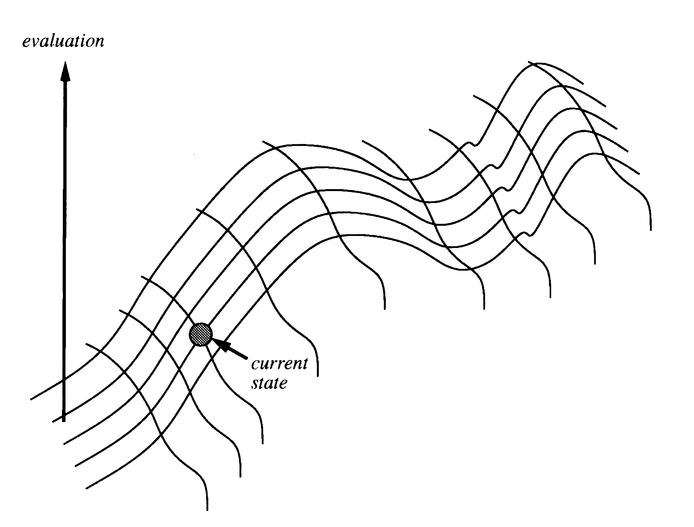
Iterative Improvement Basic Principle
“Like climbing Everest in thick fog with amnesia”

Slide 31

Hill-Climbing
Simple loop that continually moves in the direction of decreasing value
does not maintain a search tree, so the node data structure need only record the state and its evaluation.
Always try to make changes that improve the current state
Steepest-descent: pick the steepest next state
  Hill-Climbing(initial-state)
    state ← initial-state
    do forever
    next ← minimum valued successor of state
    if (h(next) >= h(state)) return current
    state ← next

Slide 32
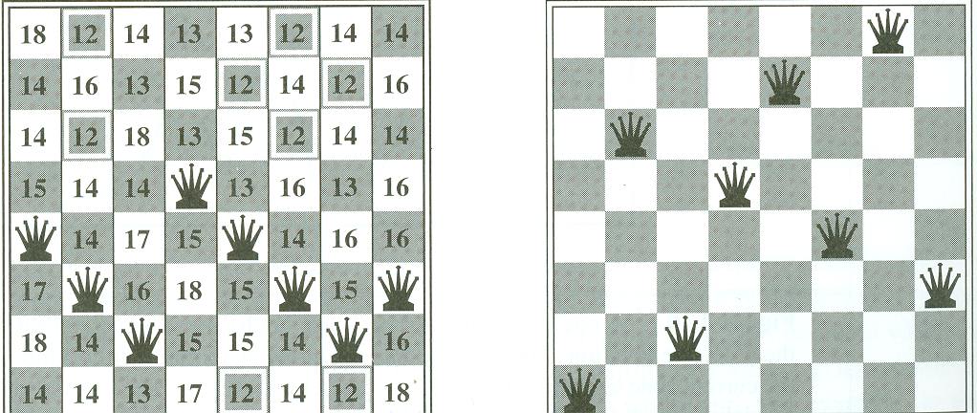
8-queens
State contains 8 queens on the board
Successor function returns all states generated by moving a single queen to another square in the same column (8*7 = 56 next states)
h(s) = number of queens that attack each other in state s.
H(s) = 17, best next is 12
H(s) = 1, local minimum

Slide 33
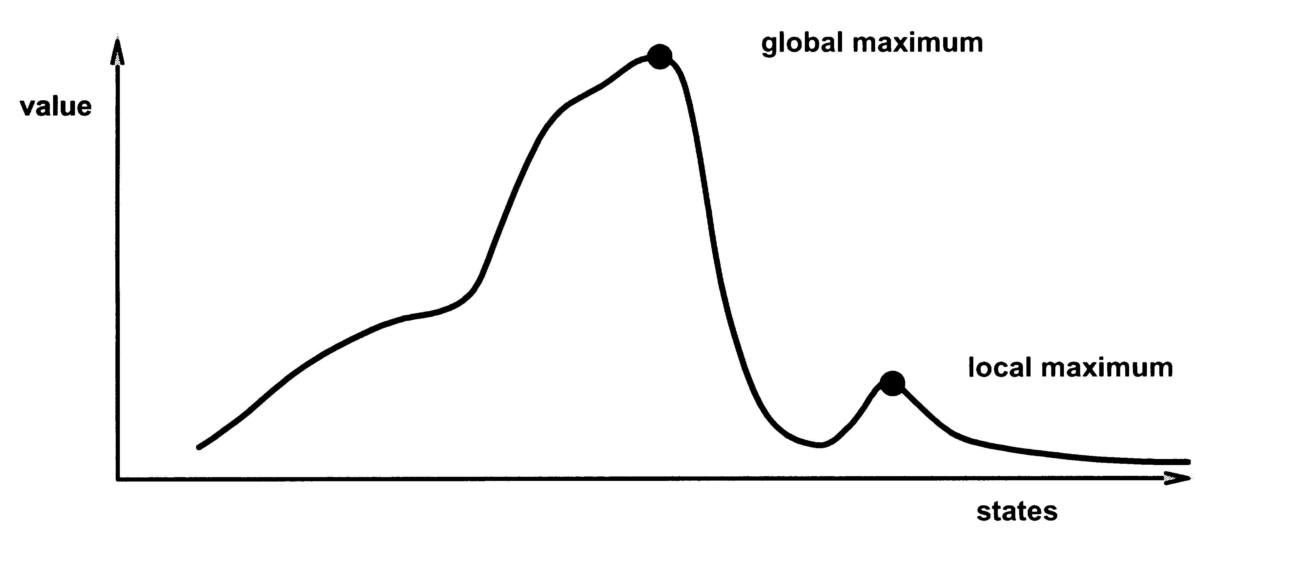
Drawbacks
Local maxima/minima : halt with local maximum/minimum
Plateaux : random walk
Ridges : oscillate from side to side, limit progress
Random-Restart Hill-Climbing
  Conducts a series of hill-climbing searches from randomly generated initial states.

Slide 34
Hill-Climbing Performance
Completeness
  Not complete, does not use systematic search method
Time complexity
  Depends on heuristic function
Space Complexity
  Very low storage requirement
Optimality
  Non-optimal solutions
  Often results in locally optimal solution

Slide 35
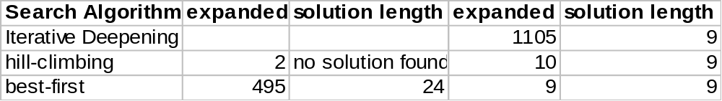
Search Performance
8-Square
Heuristic 1:
Tiles out of place
Heuristic 2:
Manhattan distance*
*Manhattan distance =.total number of horizontal and vertical moves required to move all tiles to their position in the goal state from their current position.
3 | 2 | 5
 | 7 | 1
4 | 6 | 8
 | 1 | 2
3 | 4 | 5
6 | 7 | 8
h1 = 7
h2 = 2+1+1+2+1+1+1+0=9
=> Choice of heuristic is critical to heuristic search algorithm performance.

